Slide 1


Cap 118 COMPUTER PROGRAMMING-I
Lecture #0
The kick start session

Slide 2
Course details
LTP – 3 0 0 [Three lectures/week]
Text Book
PROGRAMMING IN ANSI C, 6TH EDITION by E. BALAGURUSAMY, MC GRAW HILL

Slide 3
Course Assessment Model
Marks break up
Attendance 5
CA (2 best out of 3) 20
MTE 25
ETE 50
Total 100

Slide 4
Acknowledgements
The Khan Academy
EdX
Coursera
programmingsimplified.com
cprogramming.com
learn-c.org
Above all…
Common Sense

Slide 5
The course contents
Introduction to Programming Languages
Data Types & Operators
Control Structures
Functions
Arrays
Strings

Slide 6


Daily routine
Let us explore more as the day goes by…
Going for a morning 0900 AM Class
Going for a movie at 0900 AM
It is all about WHICH program is loaded WHEN

Slide 7


Daily routine
The flow changes
Start
Go!!!
Where
To
Go?
Class
Movie
Stop
Stop

Slide 8

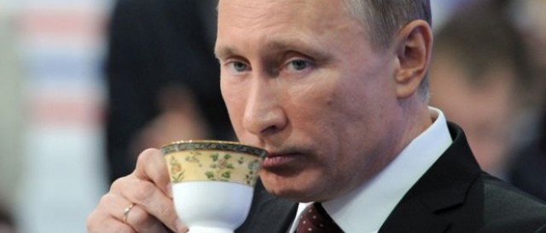




Daily routine
Yet another example but more complex
Vision
Sensor
Sipping TEA
Smell
Sensor
Radiation
Sensor
If all sensors
$$=$$
SIP
If even one is
$$=$$
Touch
Sensor
WAIT!!!

Slide 9




So what does this mean?
Take ANY activity of the day…
It will have a set procedure
It has to be done in a designate way
If not done the specified way will yield wrong results
Success in doing it depends on how closer one is to the prescribed method
This clearly shows that everything has a
Logic

Slide 10

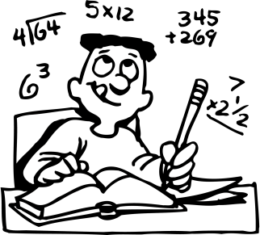
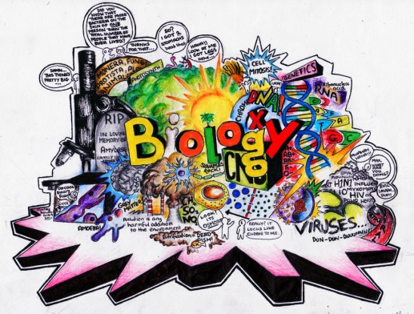





Logic, logic and logic
Logic

Slide 11
What next?
If there is logic in anything then . . .
There has to be ways to represent logic
There has to be modes to modify and re-represent logic
There should be methodology to implement and re-design logic
And for all this…

Slide 12


What next ?
There has to be logic machine to assimilate, understand, solve, store, retrieve and represent logic
There has to be a LANGUAGE to communicate with the logic machine
Otherwise….

Slide 13
Next Class: Introduction to Programming languages

